Slide 1
Building a Weather-Ready Nation
Taking Forecasts & Satellite Data to the Next Level
Dr. Louis W. Uccellini
NOAA Assistant Administrator for Weather Services
Director, National Weather Service
Satellite & Education Conference XXVII
Madison, WI
July 31, 2014

Slide 2
OutIine
Building a Weather-Ready Nation
Taking the current forecast process to impact-based decision support services
Focus on the “Last Mile” in the Forecast Process
Engaging the entire Weather Enterprise
  Weather-Ready Nation Ambassador Initiative
Evolution of Geostationary & Low Earth Orbit (LEO) Satellite Data
Summary

Slide 3

Building a Weather-Ready Nation

Slide 4
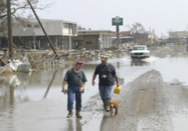
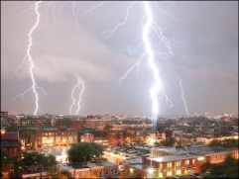
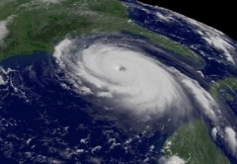
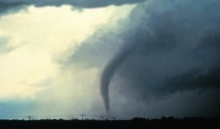
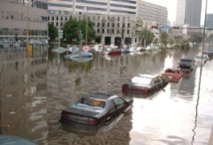
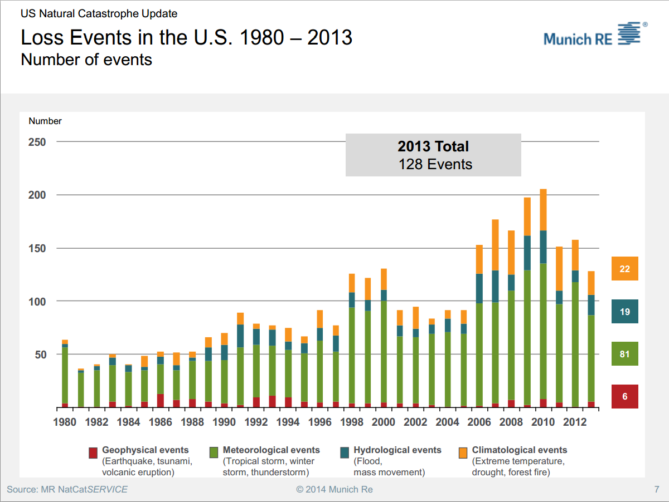
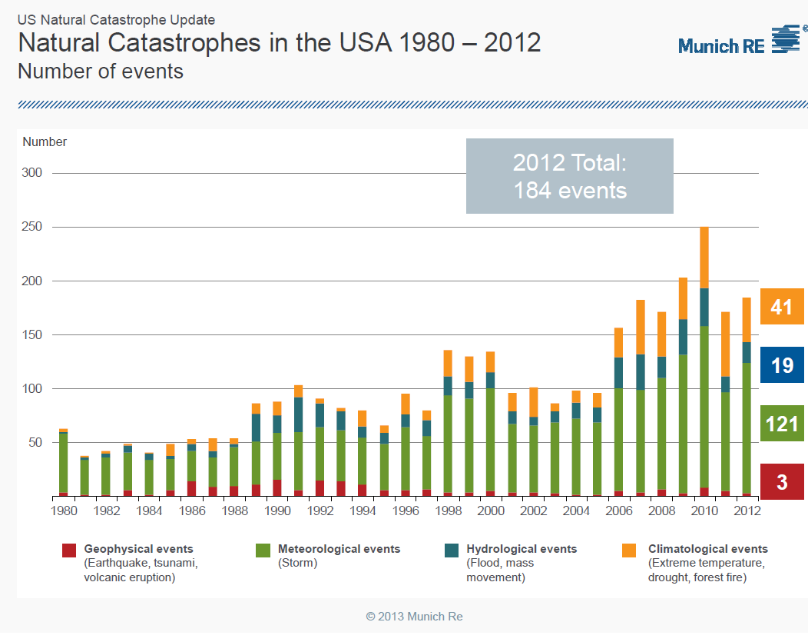

Increase in Extreme Events
“Average” Year and Trends in the U.S.
  650 Deaths
  $15B in Losses
  26,000 Severe
  Thunderstorms
  6 Atlantic Basin
  Hurricanes
  1,300 Tornadoes
  5,000 Floods
Increasing population
Increasing vulnerability
More infrastructure at risk
Improved forecasts of extreme events 4-8 days in advance
Need to take these forecasts to the next level for effective decision support
4
Notes:
4

Slide 5
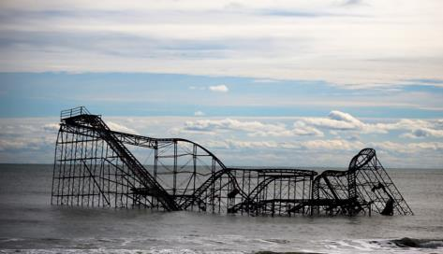
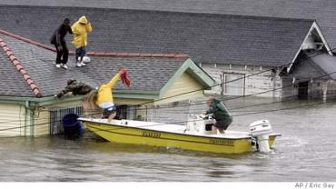
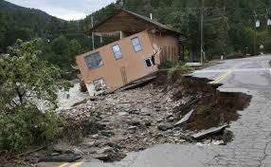
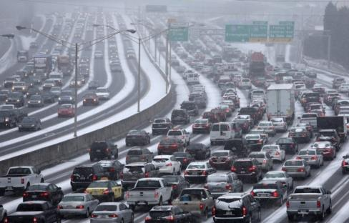
Is the U.S. Weather-Ready?
Sandy
Katrina
Eastern Colorado Floods
Atlanta - Commutageddon 2

Slide 6
NWS Strategic Outcome:
A Weather-Ready Nation
Becoming a Weather-Ready Nation is about building community resiliency in the face of increasing vulnerability to extreme weather:
“Ready, Responsive, Resilient”
REQUIRES
Better Forecasts and Warnings
Extending Forecast Accuracy and Consistency
Linking Physical and Social Sciences
Multiple Dissemination Pathways
Working with Partners to Gain Response; includes embedding NWS in Emergency Operations Centers
Involves entire US Weather Enterprise WORKING TOGETHER
to achieve far-reaching national preparedness for weather events

Slide 7
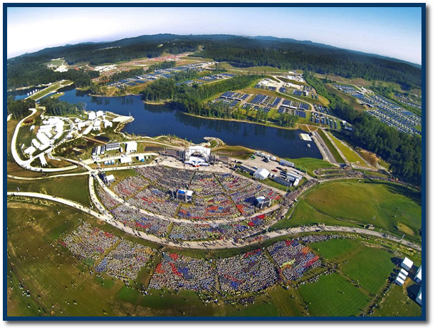
NWS Strategic Outcome:
Weather-Ready Nation
  NWS Strategic Goals
  Improve Weather Impact-Based Decision Support Services
  Improve Water Forecasting Services
  Enhance Climate Services and adapt to climate-related risks
  Improve sector-relevant information in support of economic productivity
  Enable environmental forecast services supporting healthy communities and ecosystems
  Sustain a highly skilled, professional workforce equipped with training, tools, and infrastructure to meet mission
Interdisciplinary
1. Water Quality, 2. Food 3. Health
Boy Scout Jamboree
Prediction is what makes NOAA/NWS unique and indispensable!

Slide 8
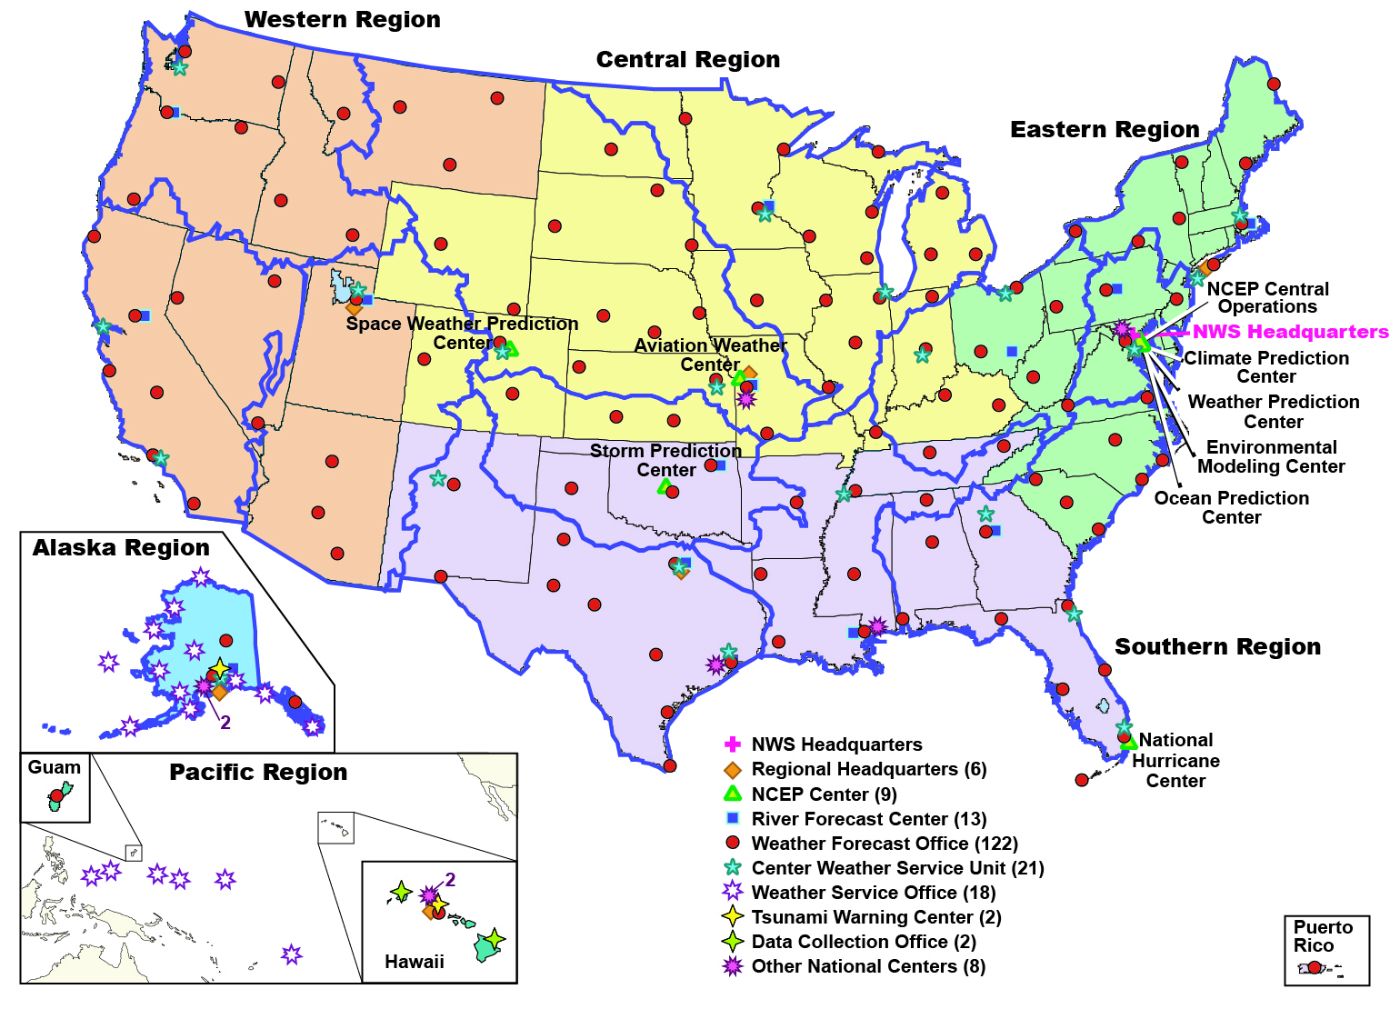
NWS Operations
Community Based Services
New!
National Water Center
8
Notes:
NWS Facilities Organization
NWS Headquarters (Silver Spring, MD)
6 Regional Headquarters
9 NCEP Centers
122 Weather Forecast Offices (WFOs)
13 River Forecast Centers (RFCs)
2 Tsunami Warning Centers
21 Center Weather Service Units (CWSUs—in cooperation with FAA)
18 Weather Service Offices
Other National Centers – National Data Buoy Center, National Training Center, National Logistics Center, Volcanic Ash Prediction Center, Tsunami Warning Center, etc.

Slide 9
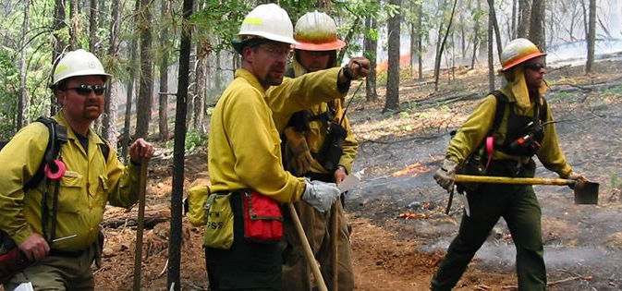
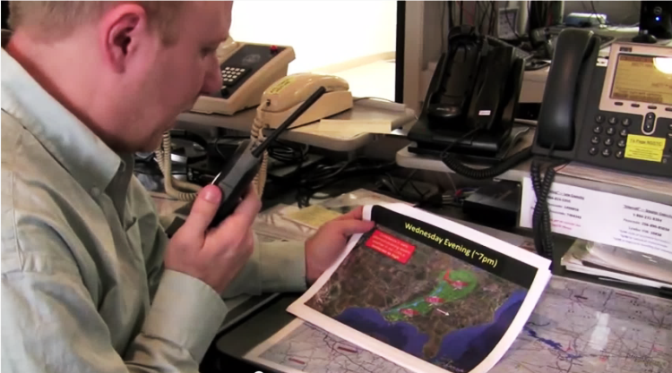
Taking the Current Forecast Process
to
Impact-Based Decision Support Services (IDSS)

Slide 10
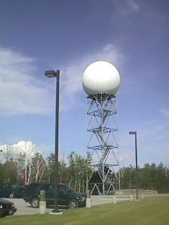
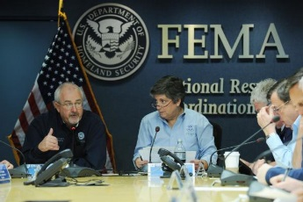
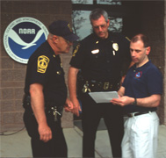
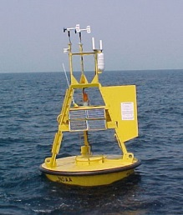

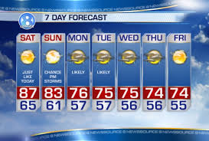
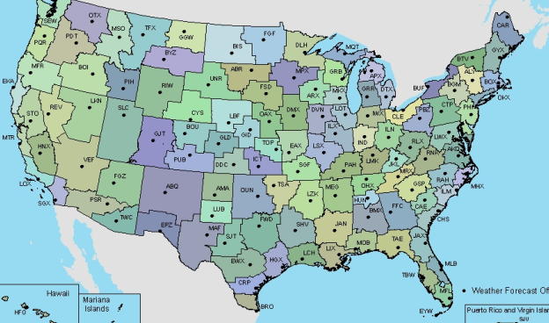
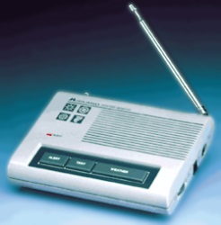
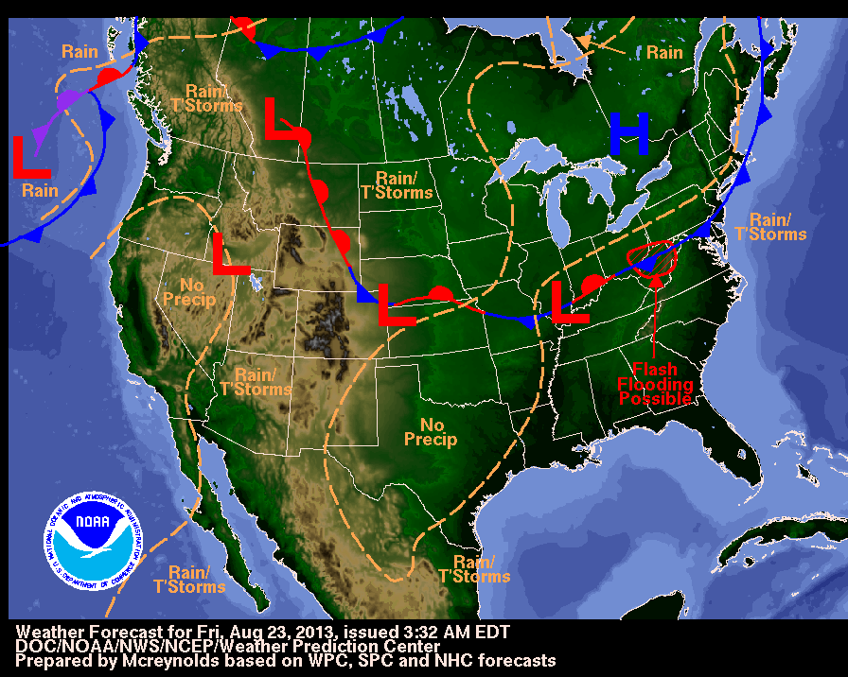
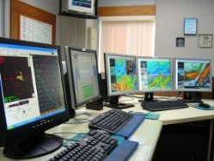
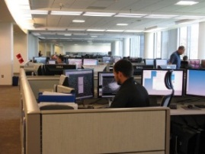

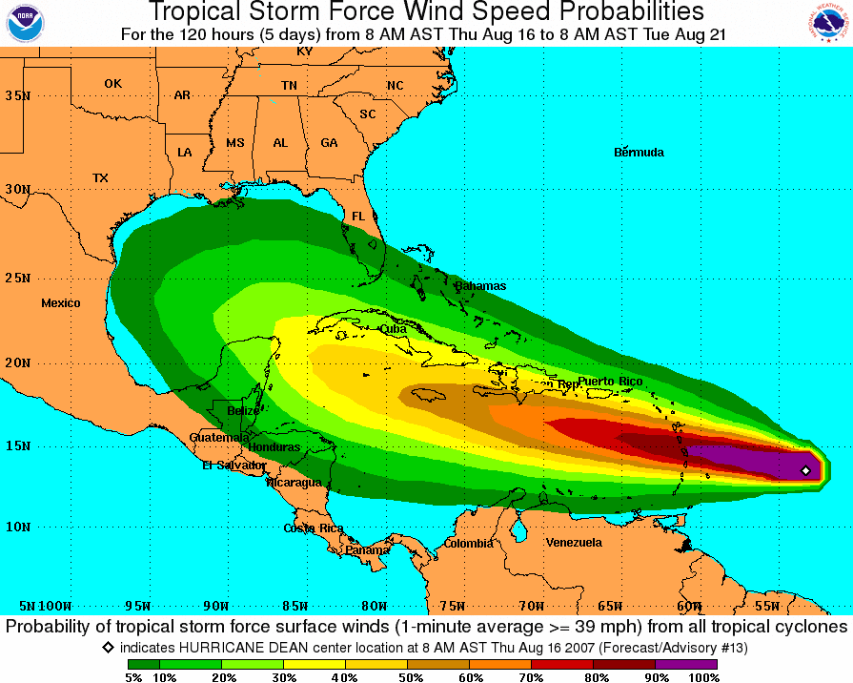
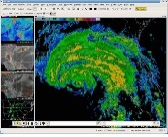
The Forecast
Process
Science &
Technology
Integration
R2O
O2R
Observations
Dissemination
Analyze, Forecast, & Support
Central
Processing
Central
Guidance
Local
Forecasts
10

Slide 11
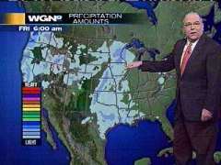
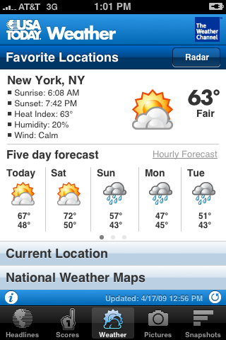
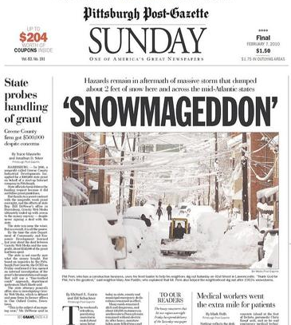


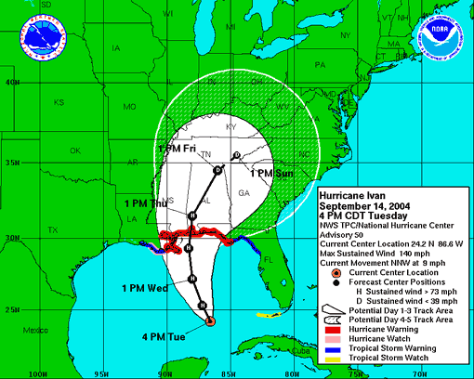
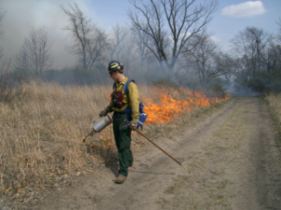
Today’s Weather Forecast
Everything you read, see or hear about weather, climate and ocean forecasts is based on numerical prediction models
Four Essential Components of the Prediction Enterprise
Global Observations
Computers (supercomputers,
work stations)
Data Assimilation & Modeling/
Science
Forecaster Skill
Notes:
11

Slide 12
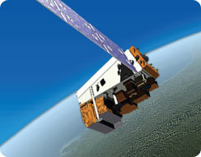
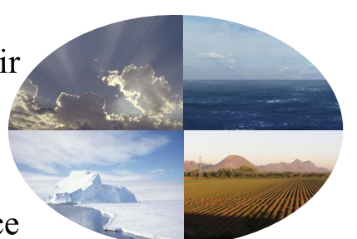
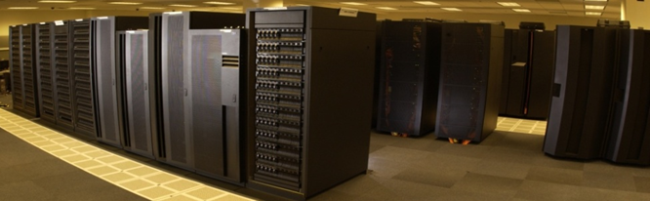
Operational Numerical
Prediction Enterprise
Observations
  ~2 billion/day
  99.9% remotely sensed, mostly from satellites
NWS Models
  Earth System model; coupled
  Global resolution (27km)(13km by Fall 2014)
  North American resolution (4km)
NOAA Operational Computer
  Transition to new IBM iDataPlex in 2013
  208 trillion calc/sec
    3X increase to 600 trillion calc/sec by 2016
Air
Sea
Ice
Land
Earth Systems Modeling
Basis for a “Seamless Suite” of Climate -> Short Term Weather Prediction
12

Slide 13
Seamless Suite of Forecasts Increasingly Based on Multi-Model Ensembles
Spanning Weather and Climate
Forecast
Uncertainty
Years
Outlook
Seasons
Guidance
Months
Climate Forecast System—NMME
Threats Assessments
2 Week
North American Ensemble Forecast System
1 Week
Global Ensemble Forecast System
Forecast Lead Time
Global Forecast System
Global Dust
Forecasts
Days
Short-Range Ensemble Forecast
Wave Ensemble
Watches
North American Mesoscale
Hours
Fire Wx
Regional Hurricane
Global Ocean
Waves
Warnings & Alert Coordination
Rapid Refresh
Space Weather
Bays
Minutes
Dispersion (smoke)
Storm Surge
Air Quality
Benefits
Tsunami
Whole Atmosphere
HRRR
NMME
NLDAS
Aviation
Recreation
Health
Commerce
Agriculture
Ecosystem
Life & Property
Maritime
Fire Weather
Reservoir Control
Environment
Hydropower
Emergency Mgmt
Energy Planning
13

Slide 14
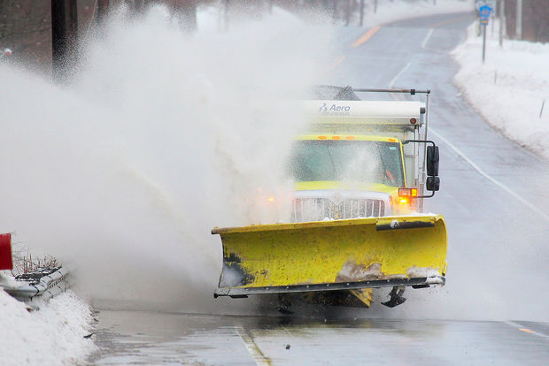
Success of a seamless suite of forecast products
linked directly to IDSS
February 13-14, 2014
Cold & Snow Event

Slide 15
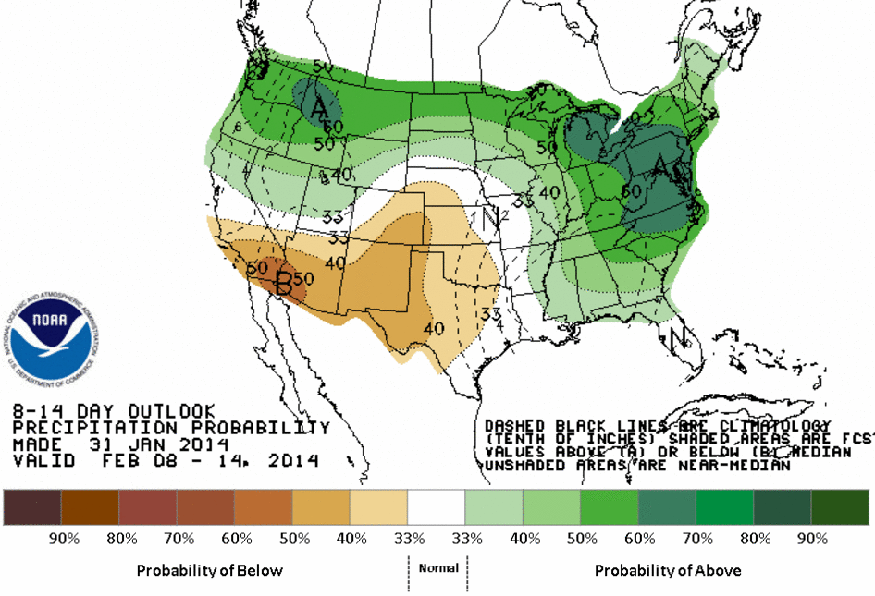
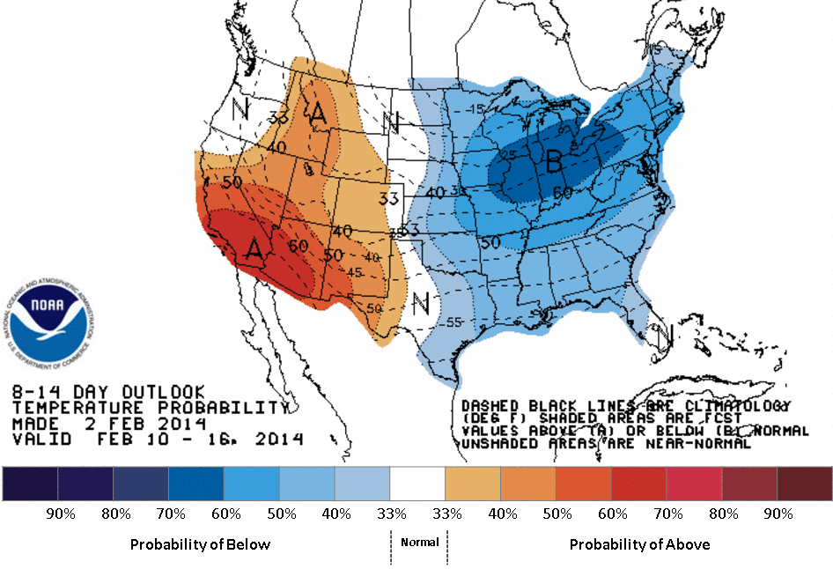
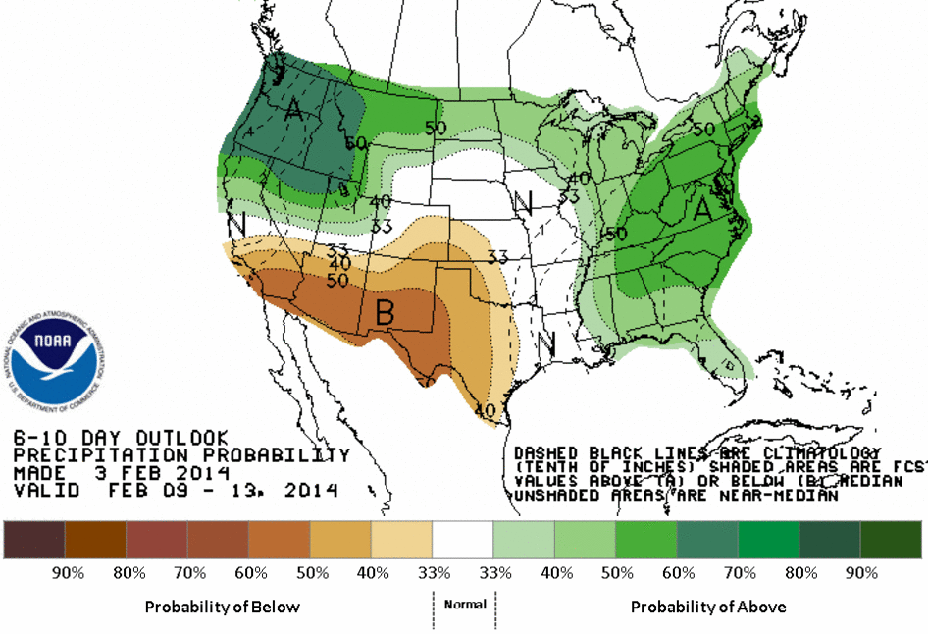
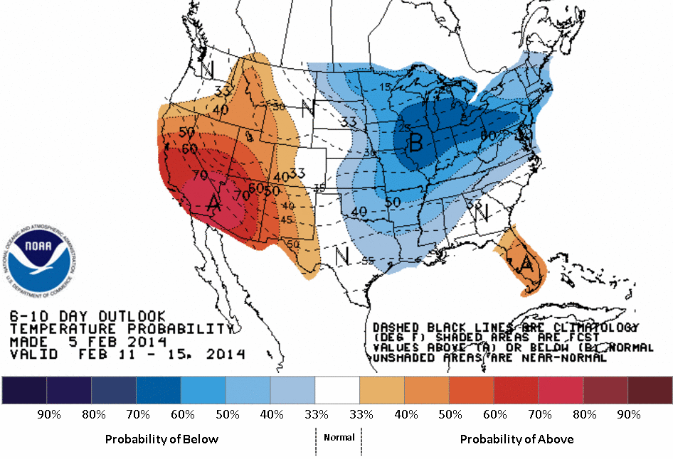
CPC Outlooks
Issued Jan 31st - Feb 5th
Days 8-14 Precipitation
Days 8-14 Temperature
Days 6-10 Precipitation
Days 6-10 Temperature
15

Slide 16
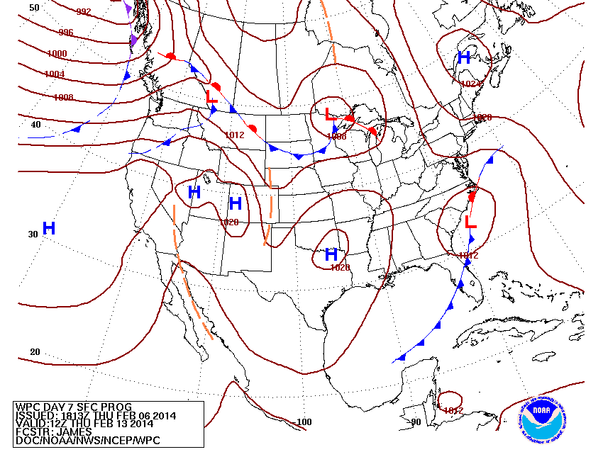
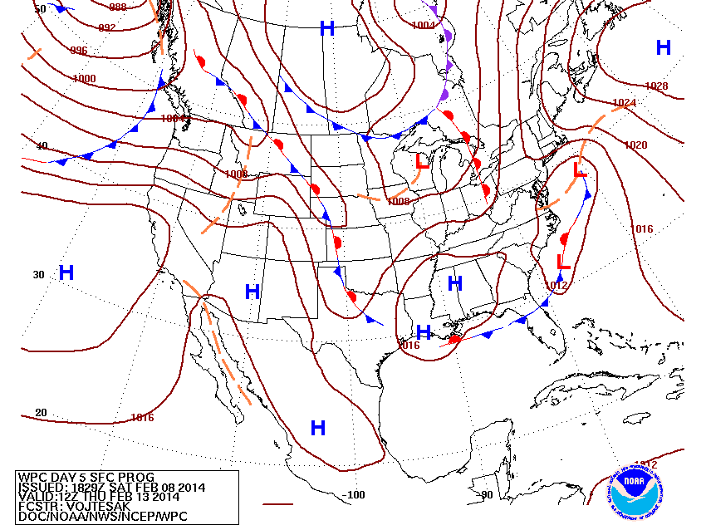
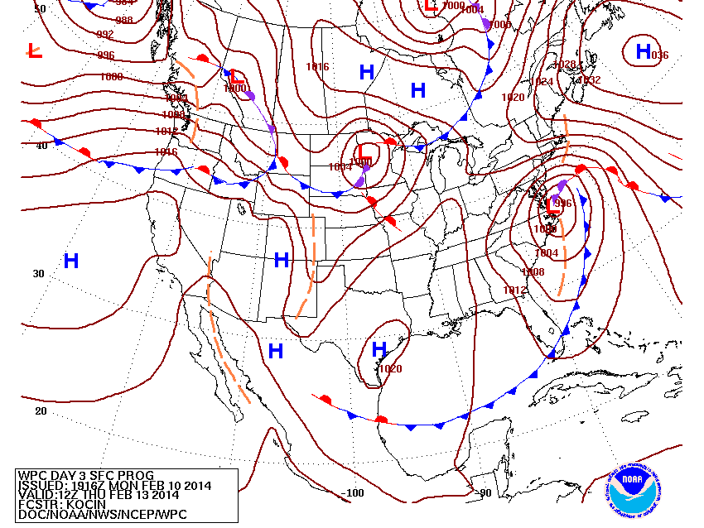
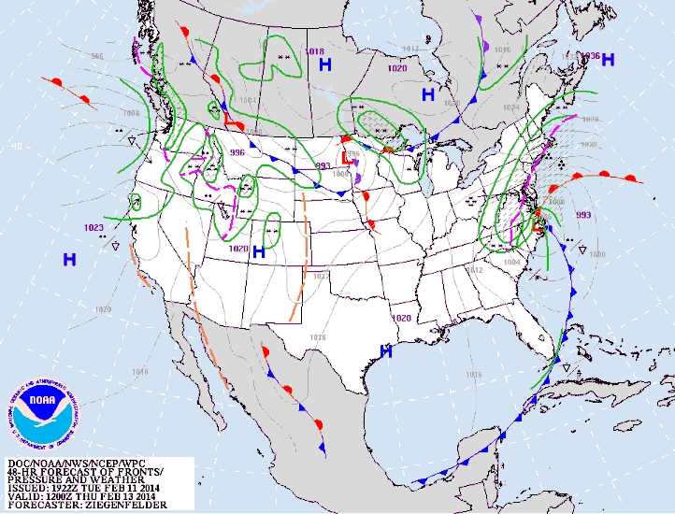
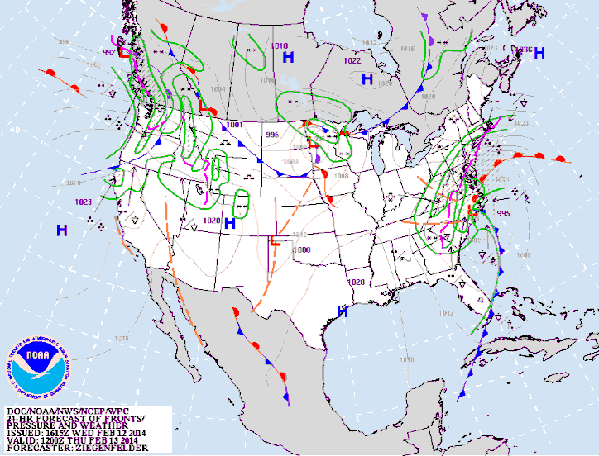
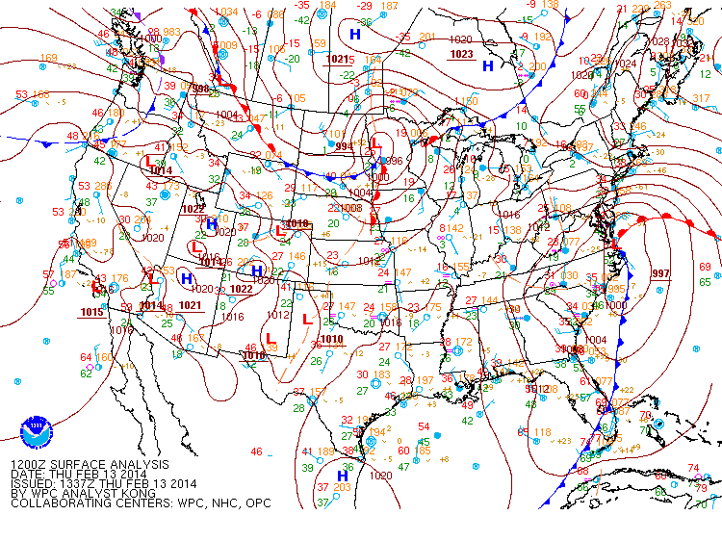
WPC Forecasts
Issued Feb 6th – 12th
Day 7
Day 5
Day 3
Day 2
Day 1
Analysis
16

Slide 17
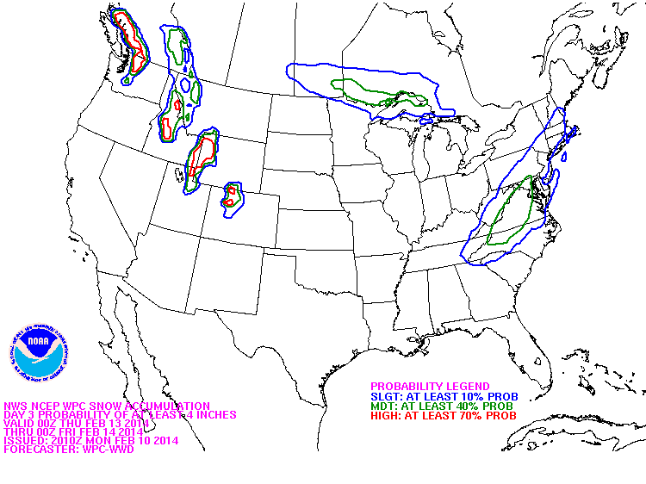
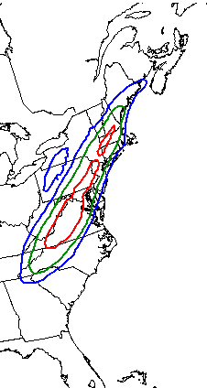
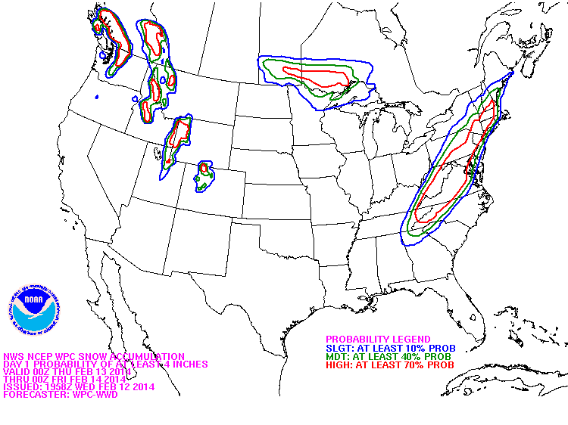
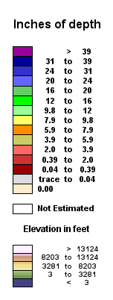

WPC Snow Forecasts
Valid 00 UTC Feb 14th
Probability of more than 4” snow
Feb 10: Day 3
Feb 11: Day 2
Feb 12: Day 1
Feb 14: Analysis
4”+
Snow Depth
17

Slide 18





13 Feb 2014 DC Snowstorm
Overnight snowfall rates of 2-3 inches per hour
1-7 am liquid-equivalent totals
DCA | ECMWF | NAM | NAMnest
0.93” | 0.40” | 0.75” | 0.80”

Slide 19

Communicating Impact
(Aviation)
3 Days Before
Criteria for DCA
Event | Slight Prob >40% | Modt Prob >40% | High Prob > 40%
3-h Snow | > 0.2” | > 0.75” | > 1.5”
24-h Snow | > 1” | > 2” | >6”
3-h Fz Rain |  | > 0.01” | > 0.05”
Visibility | < 3 mi | < 1 mi | < ½ mi
19

Slide 20

Communicating Impact
(Aviation)
2 Days Before
Criteria for DCA
Event | Slight Prob >40% | Modt Prob >40% | High Prob > 40%
3-h Snow | > 0.2” | > 0.75” | > 1.5”
24-h Snow | > 1” | > 2” | >6”
3-h Fz Rain |  | > 0.01” | > 0.05”
Visibility | < 3 mi | < 1 mi | < ½ mi
20

Slide 21

Communicating Impact
(Aviation)
1 Day Before
Criteria for DCA
Event | Slight Prob >40% | Modt Prob >40% | High Prob > 40%
3-h Snow | > 0.2” | > 0.75” | > 1.5”
24-h Snow | > 1” | > 2” | >6”
3-h Fz Rain |  | > 0.01” | > 0.05”
Visibility | < 3 mi | < 1 mi | < ½ mi
1/3 of flights canceled at DCA
21

Slide 22


Beyond Forecasts & Warnings: IDSS
Focus on the ‘Last Mile’ in the Forecast Process
The Forecast Process no longer ENDS with the meteorology
- we must take it the ‘last mile’ to be successful -
Notes:
Tinker Air Force Base Federal Credit Union Branch office in Moore, OK on I-35 next to the devastated medical center and movie theater. 14 employees and 8 customers survived in that vault which is about the only thing left of the building (22 people spared!). There were several fatalities in the immediate area I am aware of. This is EF-4 damage. They were aware of the threat with just over 40 minutes of lead time at their location, had a plan, and acted appropriately.

Slide 23












Focus on the “Last Mile”
Higdon, AL Tornado Survivors
Establishing Partnerships
Communicating Impacts
Multiple Dissemination Paths

Slide 24


Focus on the “Last Mile” in the Forecast Process
Progress since 2011 Severe Weather Season
ALABAMA
JOPLIN
Tuscaloosa, AL- April 27, 2011
St. John’s Hospital- May 22, 2011
Notes:
SLIDE 12 from TEXAS A&M
6 total deaths at the hospital, 1 direct, 5 indirect

Slide 25






Case for Change
Southeast Tornado Outbreak
April 27-28, 2011
96% of tornadoes located within SPC Watch
Ave. Warning Lead Time = 24 minutes
Deadliest outbreak since 1932
~190 tornadoes
~311 fatalities
Coordination calls with emergency managers beginning on day 3
25
Notes:
25
SLIDE 13 from TEXAS A&M

Slide 26






Case for Change
Joplin Tornado
May 22, 2011
EF-5 Intensity, 200+ mph winds, ¾ mile wide
158 fatalities – 6 fatalities in the hospital
    5 due to power outages to ventilators, 1 visitor
Deadliest tornado since modern recordkeeping began (1950)
7th deadliest tornado in U.S. history
3 Days
36 Hours
12 Hours
Notes:
SLIDE 14 from TEXAS A&M

Slide 27


Building a Weather Ready Nation:
“A Vital Conversation”
December 2011 Workshop in Norman, OK
Focus on the “last mile”: delivery of warnings
Integrate social and physical science
  Is the message delivered equal to the message received?
  Impact-based Forecast and Warnings for a wide range of decision makers (from ‘organized’ to ‘loosely coupled’ to ‘individuals’)
Assess and update warning dissemination strategy
Improve outreach and education
Notes:
SLIDE 15 from TEXAS A&M

Slide 28







Case for Change
Moore EF-5 Tornado
May 20, 2013
Convective Outlooks highlighted threat 6 days out, SPC–FEMA coordination began 4 days in advance
Norman WFO coordinated with EM/city managers 5 days in advance 31 minutes of warning lead-time for Moore, OK
EF-5 Intensity, 200+ mph winds, 1.08 miles wide
24 fatalities
6 Days
4 Days
3 Days
2 Days
Day 1 Tornado Prob

Slide 29

Ongoing Efforts to Improve
Impact-Based Decision Support Services
  Partnerships developed over 2 years focused on Moore local leaders
    Emergency managers, schools, and hospitals
  Impact-based Warning Demonstration applied in Norman (2012-current)
    Experimental in Central Region
  Multiple dissemination outlets established by Norman WFO
  Connection to the Moore Medical Center over 2 years → practice, practice, practice…
    No lives lost at the hospital
“The information you and the weather service provided us ultimately saved more lives than we could ever count.”
--Shane Cohea, Moore Medical Center
Award-winning WCM Rick Smith worked with Moore Hospital months before it took a direct hit

Slide 30







Information Delivery → Success
Midwest Tornado Outbreak
November 17, 2013
- 4th Largest November Tornado Outbreak: ~71 tornadoes, 8 fatalities
- Coordination calls with FEMA and state emergency managers 3 days in advance
- Successful dissemination - Washington, IL
Wireless Emergency Alerts (WEA)
4 Days
36 Hours
12 Hours
Notes:
30

Slide 31

Engaging the Entire Weather Enterprise
Weather-Ready Nation Ambassador Initiative

Slide 32

To Build a Weather-Ready Nation: “Can’t Do It Alone”
Demands Partnerships
NWS Ambassadors Initiative formally recognizes partnerships dedicated to building a Weather-Ready Nation
Notes:
SLIDE 8 from TEXAS A&M

Slide 33







Weather-Ready Nation Ambassadors
Who can be a part of and contribute toward building a Weather-Ready Nation?
  Government (federal/state/local)
  Weather, Water, Climate Enterprise
  Academia & educators
  Businesses & non-profits
Formal recognition of organizations that work with NOAA toward building a Weather-Ready Nation
  Promote WRN messages and themes
  Engage with NOAA on potential collaborations
  Share success stories
  Serve as an “Example”
- We now have over 600 WRN Ambassadors -

Slide 34
Importance of Education
Understanding the nature of the environment, capable of rapid and predictable change (total Earth System)
Connecting the forecasts with decision makers – Must include the social sciences to further understand decision making across the spectrum of users:
  Organized (government)
  Loosely coupled (schools, churches, Boy/Girl Scouts, etc)
  Individuals (sustained by cell phones)
In the face of forecasts provided through multiple sources, educational challenges are profound. But they must be addressed in K-12 & beyond
  Multiple sources -> conflicting information
  Users assess the risk to their own situation
  Risk factors drive decisions
  Partnerships are critical

Slide 35

NOAA Office of Education
Education Leadership, Coordination, and Partnerships
  Inter- and intra-agency activities (FEMA, Exploratorium, The Weather Channel)
  Science Teacher partnerships (AMS)
Student Opportunities
  Education Partnership Program (EPP): Undergraduate & Graduate Programs
  Ernest F. Hollings Undergraduate Scholarship Program
Competitive Education Grants and Partnerships
  Environmental Literacy Grants
  Sustained Programmatic Investments
  EPP: Cooperative Science Centers
Notes:
The Exploratorium is a museum of science, art, and human perception located in San Francisco, California.

Slide 36

Geostationary (GEO) & Low Earth Orbit (LEO) Satellite Data
Historically the use of:
GEO - Situational Awareness
LEO - Numerical Weather Prediction

Slide 37



Geostationary Satellites
Visible data initially used by forecast community for situational awareness: became the “eyes” for the forecaster
    Timely access a key
“The greatest single advancement in observing tools … was unquestionably the advent of the geosynchronous meteorological satellite. If there was a choice of only one observing tool for use in meeting the responsibilities of the NHC, the author would clearly choose the geosynchronous satellite with its present day associated accessing, processing, and displaying systems …”
Sheets, R.C., 1990. The National Hurricane Center – Past, Present, and Future. Wea. Forecasting, 5: 185-232.
37

Slide 38


Low Earth Orbit Satellites (LEO)
Higher spatial resolution for microwave and infrared data
By late 1990s, LEO data becomes the backbone of the Global Observing System for numerical models
Was not readily available to the forecaster in “real time” for situational awareness
38

Slide 39


Today
Distinction is becoming blurred as LEO data becomes more readily available in real time for situational awareness and GEO data increasingly used in Numerical Models
Aqua/MODIS Imagery of Fires
(10 JUL 2014 – Mills Canyon Fire, WA)
GOES Water Vapor Imagery
(27 APR 2011 – Southeast Outbreak)
39
High Resolution Wind

Slide 40


Geostationary Satellites (GEO)
Operational GOES Sounder Derived Products
Precipitable Water
(17 JUN 14 – Nebraska Tornado Outbreak)
Fog Product for Aviation
40
Notes:
Yet, GEO data is now used in a more quantitative model.

Slide 41

Hurricane Arthur (2014)
Geostationary IR

Slide 42

Hurricane Arthur (2014)
OSCAT

Slide 43


Entering the New
JPSS / GOES-R Era
JPSS
GOES-R
Over 2000 channels
Spectral resolution in IR/mw
Hi-Res visible (Arctic, fire, etc)
Advanced Baseline Imager
16 channels
More rapid coverage of global and focused areas
Increasing ability to blend all of this data with other data sources in real time for situational awareness & numerical forecast models

Slide 44
Opportunities for New Applications
Arctic, Fires, etc
Solidifying the standard meteorological applications by combining with other observations, including new dual-pol radar
Challenges
Ground based IT – delivering ALL this data on time, every time
Education – enforcing education standards for NWS employees (need for remote sensing credits)
Combine with all data to ensure situational awareness and numerical prediction required for a Weather-Ready Nation

Slide 45
Summary
Strategic-goal across the entire climate-weather-water enterprise: Build a Weather-Ready Nation
Includes a wide array of physical & social science challenges
Includes a cultural change in the meteorological forecast services
  From forecasts to Impact-Based Decision Support Services
Both Weather-Ready Nation and the JPSS/GOES-R era offer many new challenges for the education community
  Entering the next ‘new’ era for operational LEO/GEO satellites

Slide 46

THANK YOU!
Be Weather-Ready!

Slide 47
Sandy Supplemental
Run NWS Global Forecast Systems at higher resolution (13km) out to 10 days
Upgrade all Data Assimilation to 4D Enkf/Hybrid working from new data sets: JPSS, GOES-R, COSMIC 2
High Resolution Rapid Refresh (HRRR)
  3 kilometer resolution
  Runs every hour
Ensembles: Higher Resolutions
  Global Ensemble Forecast System (GEFS) (going from 55km to 35 km)
  Short Range Ensemble Forecast (SREF) (going from 16 km to 12 km)
  Hurricane Models (new HWRF run at 3km)
  Accelerate Storm Surge Modeling for NY, NJ, and New England
Notes:
The benefits gained from increased computing capabilities.
New computing will enable high resolution for longer forecasts.

Slide 48

GFS Parallel Runs
Northern Hemisphere
GFS = Operational GFS
ECM = Operational ECMWF
Correlation scores closer to 1 are better.
PRHW14 = Experimental GFS

Slide 49

HRRR Svr Wx: Derecho Forecast
Reflectivity Observations
HRRR 15 UTC 29 June 2012

Slide 50





HWRF Simulated Radar Reflectivity
Composite Radar Reflectivity Animation for H. Arthur
HWRF forecasts for Surface wind field, synthetic SSMI/S 37 GHz imagery, composite radar reflectivity and rainfall estimates at the time of landfall
Actual Track
HWRF Forecast Track
Notes:
synthetic SSMI/S 37 GHz imagery (brightness temps - used to detect & predict cyclone intensity based on features of the warm core)

